Slide 1
HEART DISEASE ANALYSIS AND DETECTION
Using ML MODELS, Transfer Learning & Stream-lit Deployment
Debasmita Karmakar
Email: dbsmita06@gmail.com

Slide 2
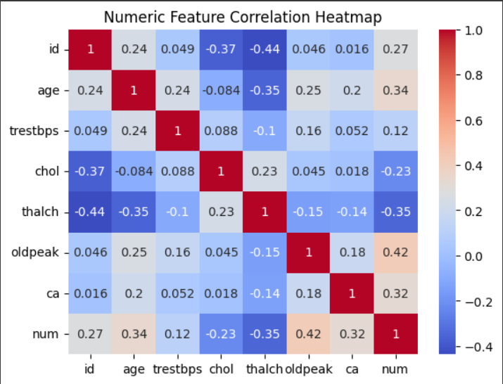
Dataset & Preprocessing
Dataset: UCI Heart Disease Dataset
Features: Age, Sex, Chest Pain Type, Blood Pressure, Cholesterol, etc.
Preprocessing steps:
Handling missing values
1. One-Hot Encoding categorical variables → 13 features → 30 columns
2. Feature scaling using StandardScaler
HEATMAP

Slide 3
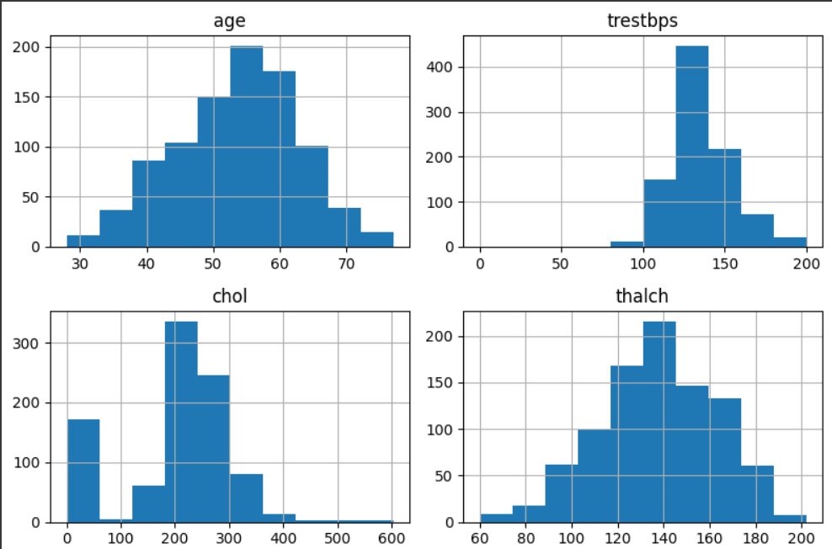
Exploratory Data Analysis
Insights:
Avg patient age ≈ 54 years
Cholesterol avg ≈ 245 mg/dl
Heart Disease prevalence ≈ 46%
histogram for all numeric values

Slide 4
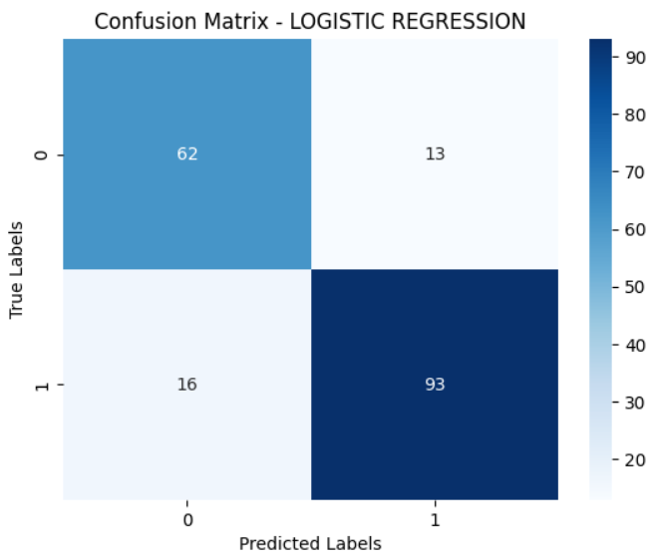
Baseline Models
Logistic Regression, Random Forest
Accuracy: 80–85%
Issues: Limited generalization, lower recall
HIGH TRUE POSITIVE - (1,1) - 93
TRUE NEGATIVE - LIGHT BLUE - (0,0) - 62
FALSE POSITIVE - (1,0) – 13
FALSE NEGATIVE - (0,1) - 16

Slide 5
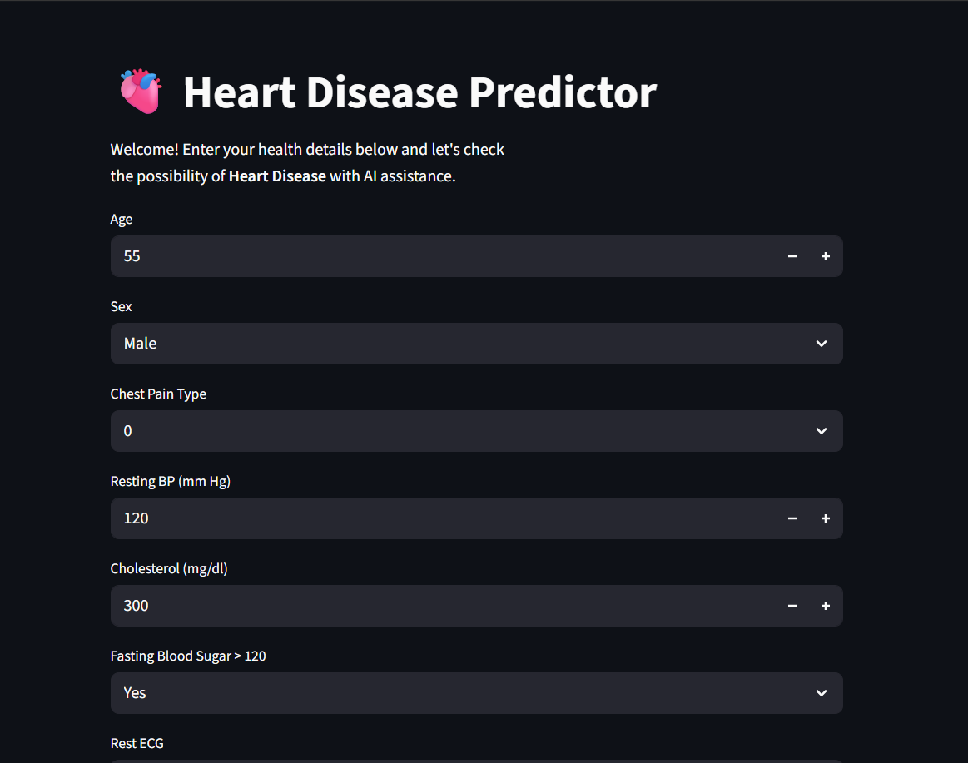
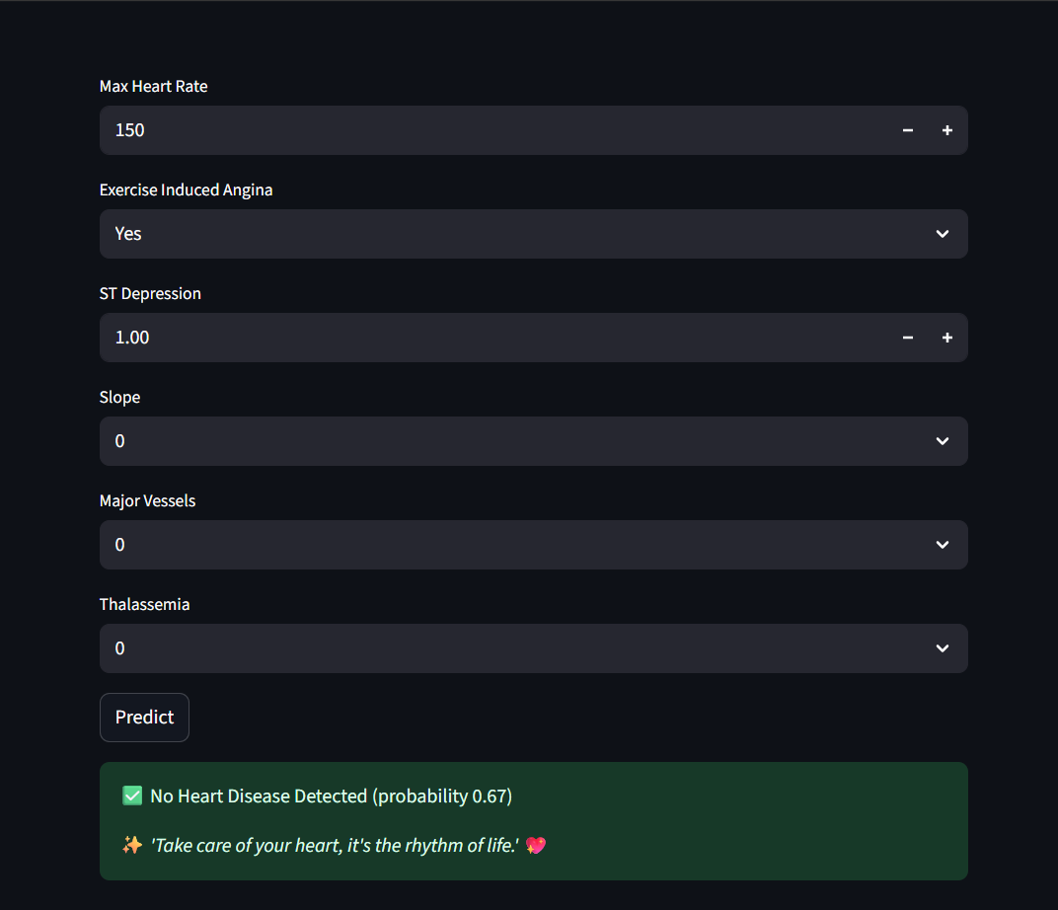
Deployment via Streamlit
Web app built with Streamlit
Features:
Single patient input (form with 13 fields)
Probability-based results

Slide 6
Results & Future Scope
✅ Achieved 87% accuracy
✅ Successfully deployed interactive app
Limitations:
Dataset size small
Model limited to heart disease only
Future Work:
Add more diseases (diabetes, liver disease)
Train on larger, diverse datasets
Deploy on hospital cloud system
THANK YOU

